Slide 1
Track Time™©
Driver database and track time analyzer
Steven An
Tim Bly
Amar Jandu

Slide 2
General Program Structure
Read in text file into a string array
Every 5 lines in the text file is a racer object
Creates a hash table of racers
Each racer has 5 string pointers that are assigned to the appropriate string in the string array
Inserts racers into the hash based on the Driver ID
Creates a BST of racers sorted Alphabetically by Driver name
BST is fed data from the hash table to further randomize order and BST balance
Users can add/delete/search/undo all previous commands

Slide 3
Racer Class (Our Primary Data Type)
Name (Used as BST Key)
licenseID (Used as HASH Key)(8 chars, first a letter, rest numbers)
Circuit Name (15 char max)
Date Lap was driven(MM/DD/YYYY)
Laptime in Seconds ( to 2 significant figs past decimal )
Example of displaying a racer:
Delia Garbacea C1234567 De Anza Circuit 12/04/2014 123.04

Slide 4
Data Structure Diagrams (Hash Table)
HashDictionary* racerDict
int itemCount
Int hashTableSize
HashDictionaryElement* hashTable
int count
LinkedList* LLArr
int count
LinkedList* LLArr
int count
LinkedList* LLArr
…
…
…
racer0
racer1

Slide 5
Data Structure Diagrams (Binary Search Tree)
BST* racerTree
int itemCount
BSTnode* root
ItemType item
BSTnode* left
BSTnode* right
racer2
racer1
racer3

Slide 6
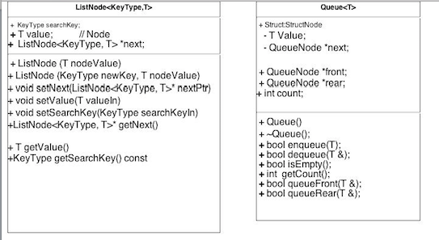
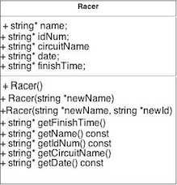

Slide 7
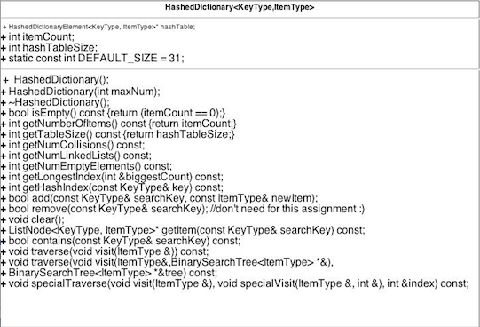

Slide 8
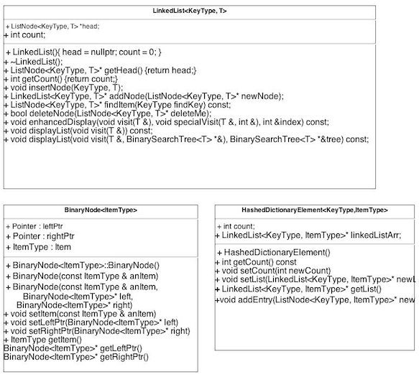

Slide 9
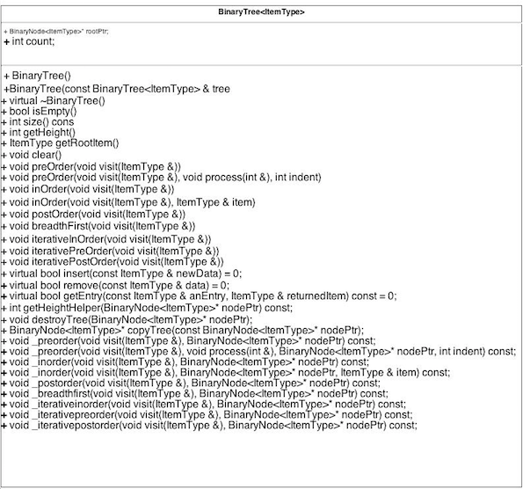

Slide 10
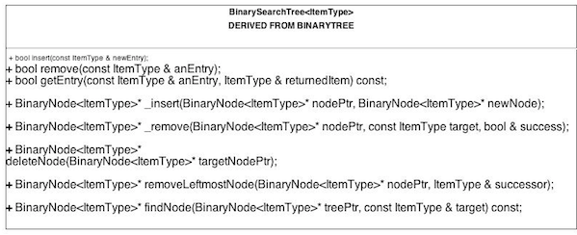

Slide 11
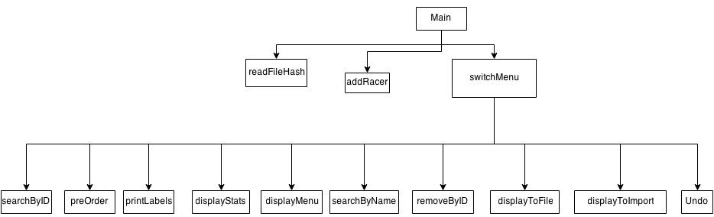
Main control structure

Slide 12
Hash Function
template<class KeyType, class ItemType>
int HashedDictionary<KeyType, ItemType>::getHashIndex(const KeyType& key) const
{
int sum = key[0];
for (int i = 0; i < key.length(); i++)
{
sum += key[i];
}
sum = sum % hashTableSize;
return sum;
//std::tr1::unordered_map<KeyType, ItemType> mapper;
//typename std::tr1::unordered_map<KeyType, //ItemType>::hasher hashFunction = mapper.hash_function();
//return static_cast<int>(hashFunction(key) % hashTableSize);
}

Slide 13
Collision Resolution
Linked Lists

Slide 14
EL FIN

